Slide 1
CMSC 603
High-Performance Distributed Systems
MPI
Dr. Preetam Ghosh
Professor
Department of Computer Science
pghosh@vcu.edu

Slide 2

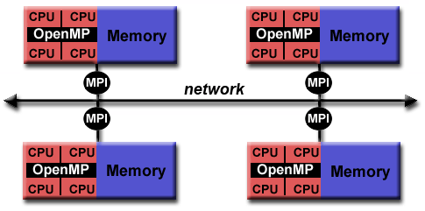
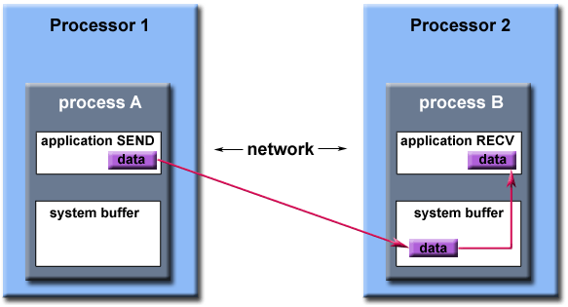
CMSC 603 - HPDS
MPI
MPI (Message Passing Interface)
  Standardized message-passing library for C/C++/Fortran
  Standard for communication among processes running on a distributed system
  Message passing between processes in the same or different machines
  Low-level of abstraction
  On maple.cs.vcu.edu MPI is loaded by default
  On athena.hprc.vcu.edu MPI must be loaded using
  $ module load mpi/openmpi-4.1.6
  Next class we’ll see how to Slurm + MPI

Slide 3

CMSC 603 - HPDS
MPI
Some definitions
  Distribution of the work and data into multiple distributed programs are based on the rank (process identification number)
  Group: group of processes that communicate with one another
  Communicator: scope of a communication operation, i.e., the group of processes involved and the context. MPI_COMM_WORLD by default
  Context: prevents an operation on one communicator from matching with a similar operation on another communicator

Slide 4
CMSC 603 - HPDS
MPI
Hello World! MPI Context initialization
  Compile mpicc hello.c -o hello (mpicxx for C++)
  Execute mpirun -np 8 hello (-np number processes) on maple
  Execute mpirun -oversubscribe -np 64 hello (np > cores) on maple
#include <mpi.h>
void main (int argc, char * argv[])
{
int rank, size;
/* Start MPI */
MPI_Init (&argc, &argv);
/* Get current process id */
MPI_Comm_rank (MPI_COMM_WORLD, &rank);
/* Get number of processes */
MPI_Comm_size (MPI_COMM_WORLD, &size);
printf("Hello world from process %d of %d\n", rank, size);
MPI_Finalize();
}
Example: hello.c

Slide 5
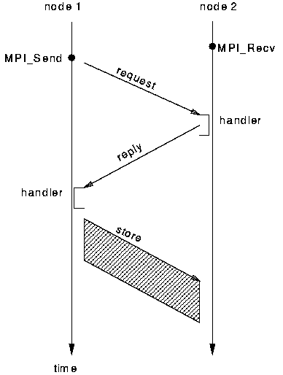
CMSC 603 - HPDS
MPI
Message Passing
  Messages among processes are handled via send/receive calls
  Communication modes:
            MPI_Send. Standard send. Completes when message is just sent (receive state is unknown)
            MPI_Recv. Receives a message and blocks until a message has arrived
            MPI_Ssend. Synchronous blocking send. Completes when the message has been received by the other process.
            Many other non-blocking , buffered, and asynchronous modes available

Slide 6
CMSC 603 - HPDS
MPI
MPI Tags
  Messages are sent with an accompanying user-defined integer TAG, to assist the receiving progress in identifying the message
  Messages can be screened at the receiving end by specifying a tag, or not screened by specifying MPI_ANY_TAG as in tag in a receive
MPI Datatypes
  The data in a message to send or receive is described by a
  triple (address + count + datatype)
  where the datatype matches the following, e.g.:
  MPI_CHAR, MPI_SHORT, MPI_INT, MPI_LONG, MPI_FLOAT, MPI_DOUBLE, etc

Slide 7
CMSC 603 - HPDS
MPI
MPI SEND
  MPI_Send(*start, count, datatype, destination, tag, comm)
  start: memory position where the message begins
  count: number of elements in the message
  datatype: type of data, MPI_CHAR, MPI_FLOAT, etc
  destination: rank of the target process in the communicator
  tag: sequence number or label
  comm: object communicator, default MPI_COMM_WORLD
  Important! MPI_Send does not wait until message is received

Slide 8
CMSC 603 - HPDS
MPI
MPI RECEIVE
  MPI_Recv(*start, count, datatype, source, tag, comm, status)
  Waits until a matching (source AND tag) message is received
  start: memory position where the message is stored
  count: maximum number of elements in receive buffer (integer)
  source: rank of the sending process or MPI_ANY_SOURCE
  tag: sequence number or MPI_ANY_TAG
  status: contains additional information (e.g. actual count)
  Receiving fewer than count is OK, but receiving more overflows the buffer

Slide 9
CMSC 603 - HPDS
MPI
MPI STATUS
  Status is a data structure allocated in the user’s program
  Allows to retrieve the tag, source and count of the message
Synchronous blocking
  MPI_Send and MPI_Recv are blocking, which means they will wait until the message has been sent and received, respectively
  MPI_Ssend also waits for the confirmation message is received
int recvd_tag, recvd_from, recvd_count;
recvd_tag = status.MPI_TAG;
recvd_from = status.MPI_SOURCE;
MPI_Get_count(&status, datatype, &recvd_count);

Slide 10

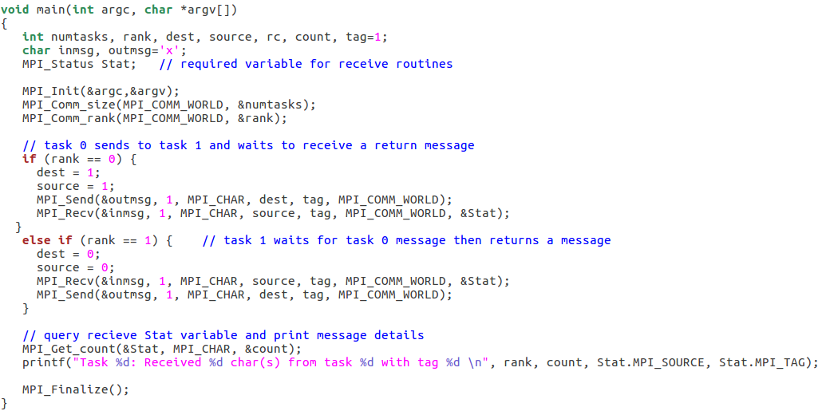
CMSC 603 - HPDS
MPI
Hello World! Communication between two processes
Example: hello2.c
Example: hello3.c

Slide 11
CMSC 603 - HPDS
MPI
Nonblocking message passing
  Nonblocking instructions always return immediately
  Messages are stored in a buffer. WARNING: Data in the send buffer subject to change before completely transmitted!!
  MPI_Isend() and MPI_Irecv() are asynchronous nonblocking calls
  The program does not stop for completing a Isend/Irecv, a communication request handle is returned for handling pending messages
  MPI_Wait() or MPI_Test() to sync / determine when message is sent / received

Slide 12

CMSC 603 - HPDS
MPI
Nonblocking message passing API
  MPI_Isend(const void *buf, int count, MPI_Datatype datatype,
  int dest, int tag, MPI_Comm comm, MPI_Request *request)
  MPI_Irecv(void *buf, int count, MPI_Datatype datatype,
  int source, int tag, MPI_Comm comm, MPI_Request *request)
  MPI_Test(MPI_Request *request, int *flag, MPI_Status *status)
  MPI_Wait(MPI_Request *request, MPI_Status *status)
  Extended functions
  MPI_Testany, MPI_Testall, MPI_Testsome
  MPI_Waitany, MPI_Waitall, MPI_Waitsome
Example: nonblocking.c

Slide 13
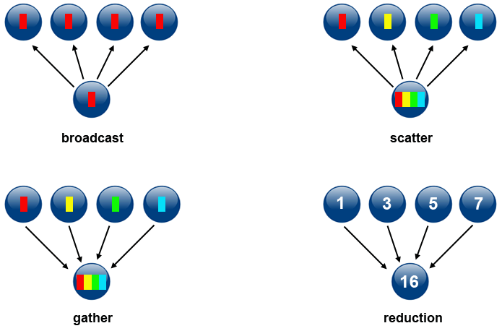
CMSC 603 - HPDS
MPI
Collective communication routines
  Synchronization (barrier): processes wait until all members of the group have reached the synchronization point
  Data movement: broadcast, scatter, gather
  Collective computation (reductions): one member of the group collects data from the other members and performs an operation (min, max, add, multiply, etc.) on that data

Slide 14
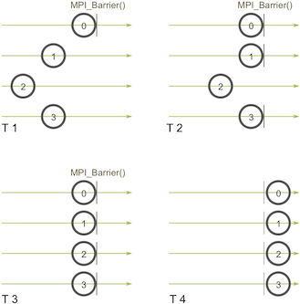
CMSC 603 - HPDS
MPI
Barrier synchronization
  MPI_Barrier (comm) creates a barrier synchronization in a group

Slide 15
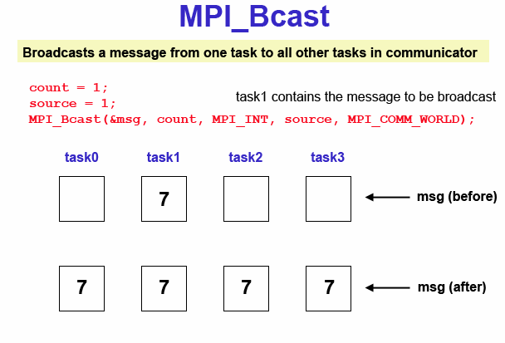
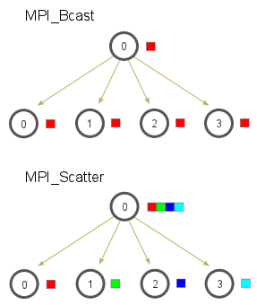
CMSC 603 - HPDS
MPI
Broadcast
  MPI_Bcast (*buffer, count, datatype, rank, comm)
  Process identified by rank sends a message to all the other processes
  The buffer will contain the message in every process
  Example: bcast.c

Slide 16
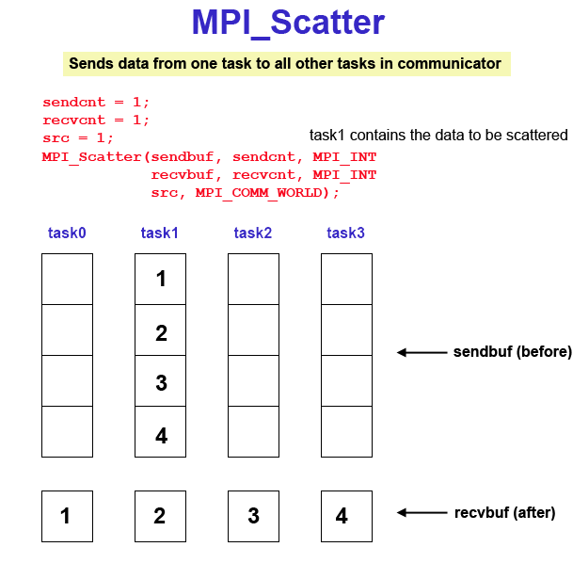
CMSC 603 - HPDS
MPI
Scatter
  MPI_Scatter (*sendbuf, sendcnt, sendtype, *recvbuf, recvcnt, recvtype, root, comm)
  Distributes distinct messages to each task in the group
  Example: scatter.c

Slide 17
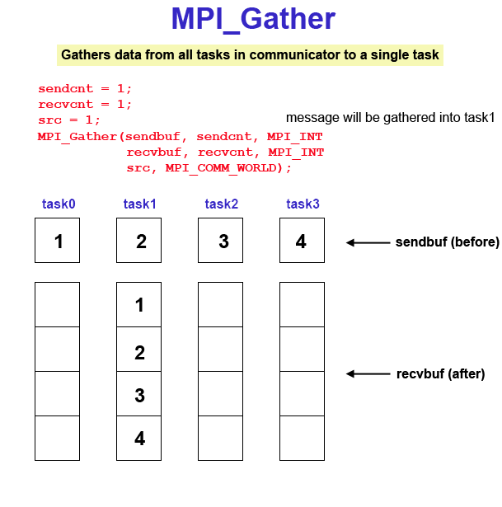
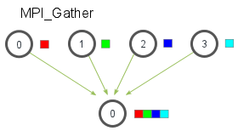
CMSC 603 - HPDS
MPI
Gather
  MPI_Gather (*sendbuf, sendcnt, sendtype, *recvbuf, recvcount, recvtype, root, comm)
  Collects messages from each task in the group to a single destination task
  MPI_Gatherv to control explicitly the locations
  Examples: gather.c and gather2.c

Slide 18
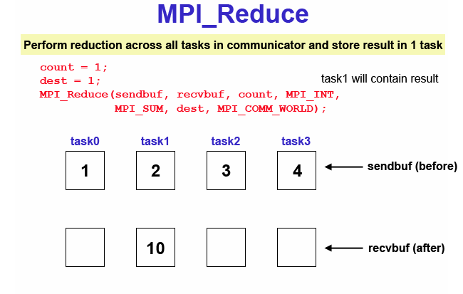
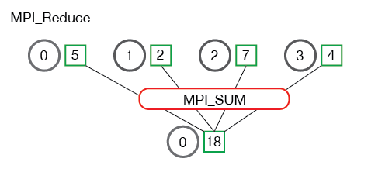
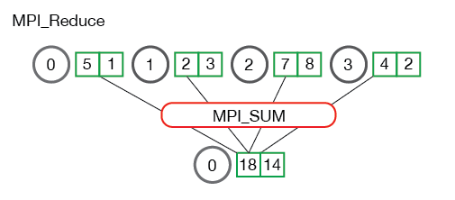
CMSC 603 - HPDS
MPI
Reduce
  MPI_Reduce (*sendbuf, *recvbuf, count, datatype, op, root, comm)
  Collects and applies a reduction operation on all tasks in the group
  Operations: MPI_MAX, MIN_SUM, MPI_PROD, MPI_LAND
  Example: reduce.c

Slide 19
CMSC 603
High-Performance Distributed Systems
MPI
Dr. Preetam Ghosh
Professor
Department of Computer Science
pghosh@vcu.edu

